Slide 1
Machine Learning
Notes:
A look the field of machine learning. We have emphasized the importance of some form of feedback to the system.
With supervised learning the agent is provided with immediate feedback so that it knows at once if it has been correct.
With unsupervised learning no feedback is provided while training is ongoing; however, eventually the agent will know if it is performing well.

Slide 2








Clustering
 | 6 | 3
 | 5 | 3
 | 2 | 3
 | 1 | 3
 | 3 | 8
 | 4 | 8
Notes:
This is an animated slide – use the notes below to talk to each animation build (clicks are indicated by numbers)
Regression and Classification are both forms of supervised machine learning.
Now let's look at a form of unsupervised machine learning – clustering.
Suppose we collect some observations of flowers, noting the height and number of petals for each sample. What we want to do is group flowers that are similar together, but we have no known label that we can use to train a model. {A table of flower heights and petal counts is shown}
Instead, we think of the feature values that we have as being coordinates on which we can plot the sample data points – in this case we have two features, height and petals, so we can plot them on a 2-dimensional grid like this. {A grid is shown with flowers plotted for each height and petal count coordinate pair}
Now we need to decide how many clusters we want to group the observations into. This value is generally referred to as K, and we simply assign K points at random locations on our grid like this. In this case, we've used a K value of 3; so we'll end up with 3 clusters. {Three centroid points are plotted on the grid at random coordinates}
Each of the K points we've plotted will be a centroid for a cluster, so we assign the sample data points to its nearest centroid. {Three shaded cluster areas enclosing the flowers that are nearest to each randomly plotted centroid is added}
Now we move each centroids to the middle of the points in its cluster – based on the mean distance. {The centroid points are moved to the center of the flowers in their cluster}
Now that the centroids have moved, some sample points might be nearer to a different centroid from the one they're currently allocated to; so we reallocate the samples to their nearest centroid. {The cluster shapes are redrawn to reflect the flowers that are now closest to each centroid}
And then we just repeat the process until the clusters are stable, or we reach a pre-determined maximum number of iterations. In this case, the clusters soon stabilize as well-separated groups of related flowers. {The centroids are iteratively moved to the middle of their cluster and the clusters reallocated until a stable set of separated clusters is defined and the centroids are fixed in the middle of their flowers}
This clustering technique, which uses K centroids and moves them to the mean distance between their data points is known as K-Means clustering.

Slide 3
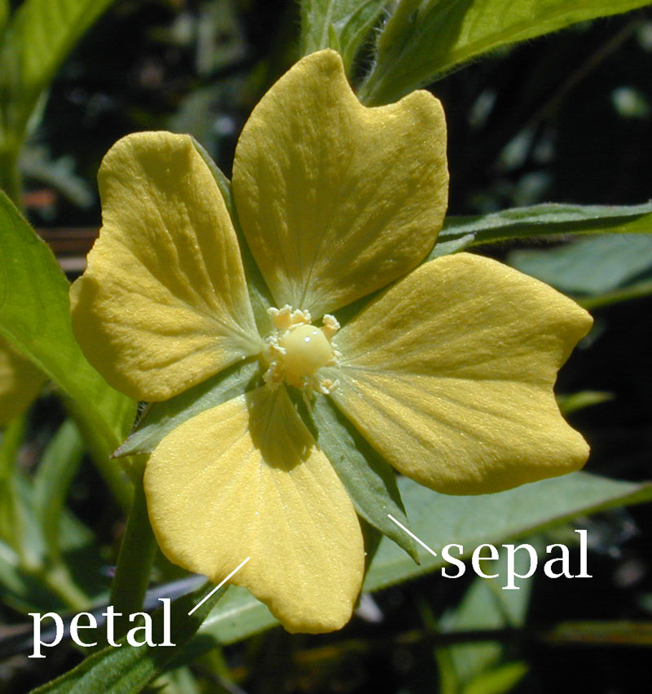
Example: Using K
Problem: how to identify different flower species given a set of features?
given the following fictitious data set.
Q1: how many species?
Q2: supervised or unsupervised?
Sample ID | Sepal length | Sepal width | Petal length | Petal width
1 | 6.1 | 3.2 | 1.7 | 0.4
2 | 5.9 | 2.9 | 1.4 | 0.3
3 | 2.7 | 1.2 | 4.3 | 1.6
4 | 3 | 1.6 | 5.9 | 2.0
5 | 2.9 | 1.5 | 3.0 | 3.5
6 | 2.4 | 1.1 | 2.9 | 3.2

Slide 4
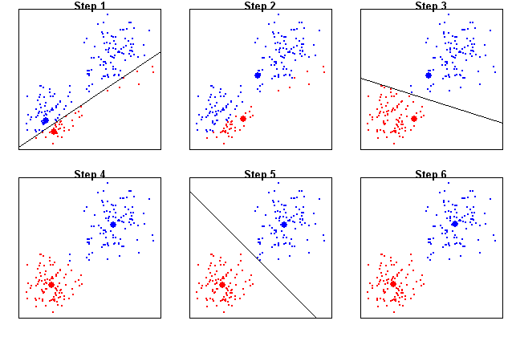
Decision: When will it stop?
A two species and two features case learnt by machine
Learning steps:
1. initialize two cluster centers;
2. assign samples to clusters;
3. locate new cluster centers.
repeat Step 2 and Step 3.
in-class Q3: when does the machine stop?
Pedal height
pedal width
Notes:
Another way to ask: when does the algorithm terminate? Or when does the repeating stop?

